Slide 1
EMOTION RECOGNITION
Sayali Chaudhari
Apeksha Shetty
Aditya Chinnamalla
Shivam Naik
Roshan Singh
Akkshay Bhakta

Slide 2
Introduction
Emotion recognition is the process of identifying human emotion, most typically from facial expression as well as from verbal expressions.

Slide 3

Problem Statement
Our Human face portrays mixed emotion, so we are going to predict whether the facial expression of a person depicts anger, sadness, happiness, fear, disgust or neutrality by calculating the probabilities of these emotions.

Slide 4
Dataset Overview
We are using fer2013 ( FACIAL EMOTION RECOGNITION) dataset.
Dataset link- https://www.kaggle.com/c/challenges-in-representation-learning-facial-expression-recognition-challenge/data
The data consists of 48*48 pixel grayscale images of faces.
The dataset contains two columns: emotions and pixels
The ‘emotions’ column contains a numeric code ranging from 0 to 6, inclusive, for the emotion that is present in the image.
The ‘pixels’ column contains a space-separated pixel value for each image.
The training set consists of 28,709 examples.
The test set consists of 3,589 examples.

Slide 5
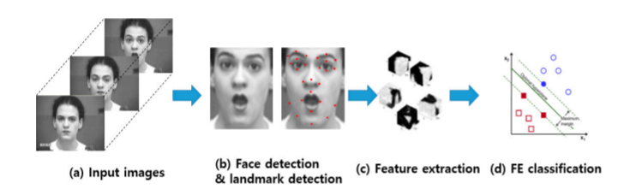
Approach
First, a face image is detected from an input image, and facial components (eg., eyes and nose) or landmarks are detected from the face region.
Second, various spatial and temporal features are extracted from the facial components.
Third, the pre-trained FE classifiers, such as support vector machine(SVM), AdaBoost and random forest produce the recognition results using the extracted features.

Slide 6
Data Preprocessing
def preprocess_input is a standard way to pre-process images by scaling them between -1 to 1.
Images are scaled to [0,1] by dividing it by 255. Further, subtraction by 0.5 and multiplication by 2 changes the range to [-1,1].
[-1,1] has been found a better range for neural network models in computer vision problems.

Slide 7
Models Used
CNN
SVM
Random Forest

Slide 8
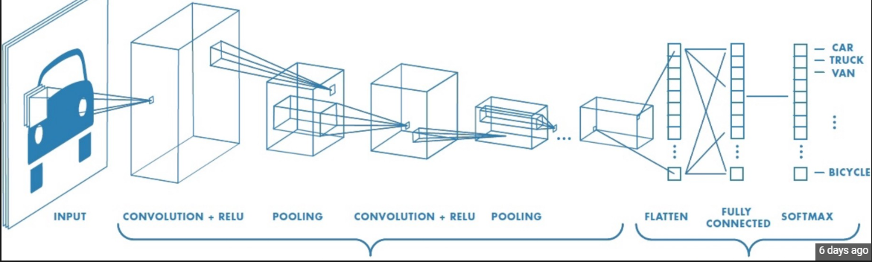
CNN
CNNs are artificial neural networks, it automatically detects the important features without any human supervision.
CNN is a collection of two types of layers -
The hidden layers / Feature Extraction Part
Convolutions
Pooling
2. The classifier part

Slide 9
Notes:
CNN’s make use of filters (also known as kernels), to detect what features, such as edges, are present throughout an image. A filter is just a matrix of values, called weights, that are trained to detect specific features. The filter moves over each part of the image to check if the feature it is meant to detect is present, the resulting value is high If the feature is not present, the resulting value is low.
We perform multiple convolutions on an input, each using a different filter and resulting in a distinct feature map.
pooling to reduce the dimensionality.
type of pooling is max pooling which just takes the max value in the pooling window.
Average pooling which just takes the avg of all the values in the pooling window.
Then we flatten the output of the final pooling layer to a vector and that becomes the input to the fully connected layer.
Fully connected layer- is used to classify images between different category by training.
Consist of softmax for multiple classification which classifies 7 output labels in our case.

Slide 10
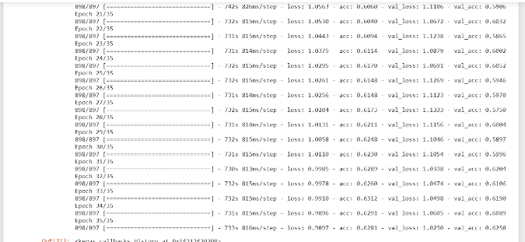
After running 35 epochs, we got an accuracy of 63%.

Slide 11
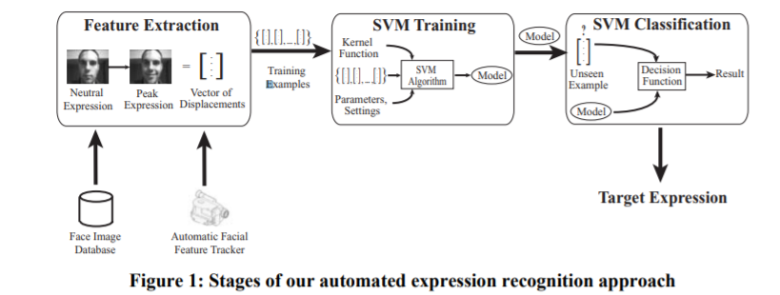
SVM
SVMs are supervised learning models
It chooses its decision boundary that maximizes the distance from the nearest datapoint of all the classes.
The objective is to find a maximum marginal hyperplane that best divides the dataset into classes.
Notes:
SVMs are supervised learning models. It chooses its decision boundary that maximizes the distance from the nearest datapoint of all the classes. The objective is to find a maximum marginal hyperplane that best divides the dataset into classes.

Slide 12
Random Forest
Random Forest is a flexible, easy to use machine learning algorithm and is considered to be highly accurate and robust. It takes the majority vote of all the predictors and cancels bias
Classification on an input image is carried out by randomly extracting sub windows in the image and propagating scaled sub windows down each tree in the forest. Votes from each of the random trees for all sampled sub windows are aggregated. A simple voting scheme with majority ruling awards the corresponding class labels
Notes:
SVM and RF did not work well for this data because the input is in the form of 3 dimensional. Neural network accepts 3 dimensional array input. But the SVM and RF accepts 2d array dimension. We tried converting to 2d array but then it hampers the shape of the input data.

Slide 13
Expected Insights
Learn how to deal with unstructured data in the form of pixel.
Introduction to Computer Vision.
Conceptualize our understanding of success and failures of algorithms.
Classify emotions based on probabilities.
Conventional FER approaches consists of three steps, namely, face and facial component detection, feature extraction and expression classification.

Slide 14


Slide 15
THANK YOU

